Slide 1
Apache Tomcat

Slide 2
Apache Tomcat Process
Certainly, here's a simplified overview of the Apache Tomcat process in five key points:
Deployment: You deploy your Java web application to Tomcat by placing a WAR file in its “web apps" directory.
Request Handling: Tomcat listens for incoming HTTP requests on a specified port and directs requests to the appropriate servlet or JSP within your web application.
Servlet Container: Tomcat manages the lifecycle of servlets and JSP pages, loading and initializing them as needed to process requests.
Application Logic: Your Java web application's logic, such as database access and business operations, is executed within servlets and JSPs.
Response Generation: Tomcat constructs an HTTP response by combining the output of servlets and JSPs and sends it back to the client, typically a web browser.

Slide 3
Configuration of Apache Tomcat
The main configuration files in a typical Tomcat setup include:
server.xml: This file contains server-wide configuration settings, including connector configurations (e.g., HTTP or AJP connectors), global security settings, and service definitions.
web.xml: This file is specific to each web application and resides within the WEB-INF directory of the application. It defines deployment-specific settings like servlet mappings, initialization parameters, error pages, and security constraints.
These configuration files play a crucial role in customizing and configuring Tomcat server behaviour and individual web applications.

Slide 4
"Configure Tomcat for various purposes, such as deploying web applications and setting up connectors, by editing the relevant configuration files (e.g., server.xml, web.xml) to define settings, customize context, and specify network protocols, and then restart the Tomcat server for the changes to take effect.“
"Common configuration tasks in Tomcat include setting up data sources (e.g., JDBC connections), defining security constraints, configuring session management, and adjusting memory allocation parameters to optimize server performance."

Slide 5
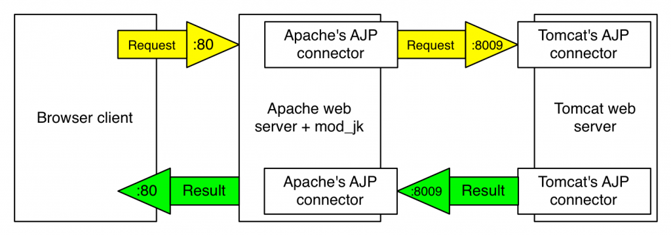
Flowchart of Request Handling

Slide 6
Advantages and Disadvantages
List of advantages:
Portability, open-source nature, and community support.
Scalability and flexibility.
Support for Java EE specifications.
List of disadvantages:
Learning curve for beginners.
Memory consumption in large-scale applications.
Lack of some advanced features compared to full Java EE application servers.

